Slide 1
Abnormal Psychology Clinical Perspectives on Psychological Disorders 5e
Psychopathology
Perspectives in Psychopathology
Dr. Amna Khawar
Department of Applied Psychology
Lahore College for women University
Lahore
Richard P. Halgin
Susan Krauss Whitbourne
University of Massachusetts at Amherst
slides by Travis Langley
Henderson State University

Slide 2
Perspectives in Abnormal Psychology
A perspective an orientation to understanding the causes of human behavior and the treatment of abnormality
The Purpose of Theoretical Perspectives in Abnormal Psychology
Theoretical perspectives influence the ways in which clinicians and researchers interpret and organize their observations about behavior.

Slide 3
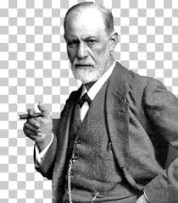
Psychodynamic Perspective
Psychodynamic Perspective
Sigmund Freud (1856-1939)
Sigmund Freud (1856-1939)
Notes:
The psychodynamic perspective is a theoretical orientation that emphasizes unconscious determinants of behavior and is derived from Freud's psychoanalytic approach.

Slide 4
Structure of mind
Conscious
Subconscious
Unconscious

Slide 5
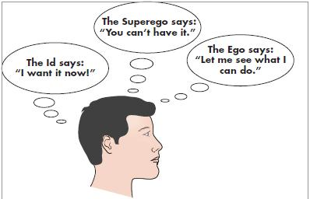
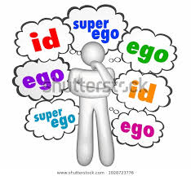
The structure of Personality
Id
Ego
Super ego

Slide 6
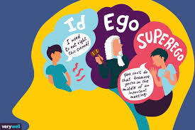
In Freudian theory, the ID is the instinctive, inborn part of personality.
The EGO is the center of conscious awareness.
the SUPEREGO controls the ego’s pursuit of the id’s desires.

Slide 7
Ego Defense Mechanisms
Various tactics people use to keep unacceptable thoughts, instincts, and feelings out of conscious awareness.
Tactics people use to protect themselves from anxiety by keeping unacceptable thoughts, instincts, and feelings out of conscious awareness.

Slide 10
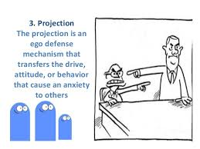

Slide 13
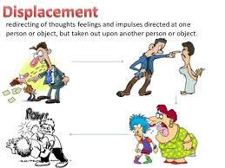

Slide 14
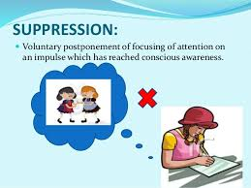

Slide 15
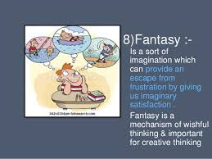

Slide 16
Psychosexual stages of development
Oral
Anal
Phallic
Latency
Genital
Notes:
Freud proposed that there is a normal sequence of development through a series of what he called psychosexual stages, with each stage focusing on a different sexually excitable zone of the body.
The ORAL STAGE (0-18 months): The main source of pleasure for the infant is stimulation of the mouth and lips.
The ANAL STAGE (18 months-3 years): The toddler's sexual energy focuses on stimulation in the anal area from holding onto and expelling feces.
In the PHALLIC STAGE (3-5 years): The genital area of the body is the focus of the child's sexual feelings. During the phallic stage, the child becomes sexually attracted to the opposite sex parent. Freud (1913) called this scenario in boys the Oedipus complex.
The parallel process in girls is called the Electra complex.
According to Freud, following the turmoil of the Oedipus complex, the child's sexual energies recede entirely during LATENCY (5-12 years).
In the GENITAL STAGE (12 years through adulthood): The adolescent must learn to transfer feelings of sexual attraction from the parent figure to opposite-sex peers.
In FIXATION, the individual remains at a stage of psychosexual development characteristic of childhood.

Slide 17
Psychoanalysis
Free Association
Dream Analysis
Analysis of Humour
Analysis of Slips of tongue
Analysis of Resistance

Slide 18
Humanistic Perspective
Person-Centered Theory (Rogers)
Notes:
At the core of the humanistic perspective is the belief that human motivation is based on an inherent tendency to strive for self-fulfillment and meaning in life, notions that were rooted in existential psychology.
Carl Rogers' person-centered theory focuses on the uniqueness of each individual, the importance of allowing each individual to achieve maximum fulfillment of potential, and the need for the individual to confront honestly the reality of his or her experiences in the world.
Carl Rogers (1902-1987) said that a well-adjusted person's self-image should match, or have congruence with, the person's experiences.
Parents may set up what Rogers referred to as conditions of worth in which the child receives love only when he or she fulfills certain demands.

Slide 19
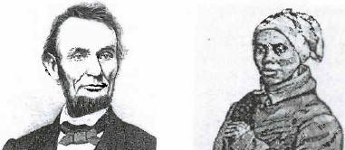
Humanistic Perspective
Person-Centered Theory (Rogers)
Self-Actualization Theory (Maslow)
Notes:
Maslow's self-actualization theory focuses on the maximum realization of the individual's potential for psychological growth.
Maslow's theory is best known, perhaps, for its pyramid-like structure which he called the hierarchy of needs.
The basic premise of the hierarchy is that, for people to achieve a state of self-actualization, they must have satisfied a variety of more basic physical and psychological needs.
Like Rogers, Maslow (1971) defined psychological disorder in terms of the degree of deviation from an ideal state and had similar views about the conditions that hamper self-actualization.

Slide 20
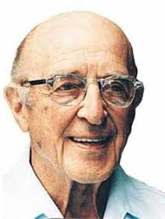
Humanistic Perspective
Person-Centered Theory (Rogers)
Notes:
In client-centered therapy, Rogers recommended that therapists treat clients with unconditional positive regard and empathy, while providing a model of genuineness and willingness to self-disclose.
Rogers focused on the extent to which a person experiences incongruence between the "actual self" and the "ideal self."
Lacking in humanistic research are some of the fundamental requirements for a scientific approach such as using appropriate control groups.

Slide 21
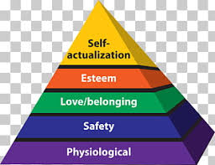
Self-Actualization Theory (Maslow)

Slide 22
Sociocultural Perspective
Theorists within the sociocultural perspective emphasize the ways that individuals are influenced by people, social institutions, and social forces.

Slide 23
Family Perspective
Proponents of the family perspective see abnormality as caused by disturbances in family interactions and relationships.
Notes:
Intergenerational approach emphasizes how parents' experiences in their own families of origin affect their interactions with their children.
Structural approach assumes that, in normal families, parents and children have distinct roles, and there are boundaries between the generations.
Strategic approach focuses on the resolution of family problems.
Experiential approach emphasizes the unconscious and emotional processes.

Slide 24
Sociocultural Perspective
Social discrimination
Social influences & historical events
Treatment:
Family therapy
Group therapy
Multicultural approach
Milieu therapy
Notes:
Psychological disturbance can also arise as a result of discrimination associated with such attributes as gender, race, or age, or of pressures associated with economic hardships.
People can also be adversely affected by general social forces such as fluid and inconsistent values in a society and destructive historical events such a political revolution, natural disaster, or nationwide depression.
Treatments within the sociocultural perspective are determined by the nature of the group involved.
In family therapy, family members are encouraged to try new ways of relating to each other and thinking about their problems.
In group therapy, people share their stories and experiences with other, similar people.
Multicultural approach: Skills involve culture-specific therapy techniques that are responsive to the unique characteristics of the clients.
Milieu therapy provides a context in which the intervention is the environment, rather than the individual, usually consisting of staff and clients in a therapeutic community.

Slide 25
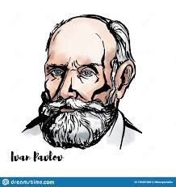
Behavioral Perspective
Classical Conditioning (Pavlov)
Notes:
According to the behavioral perspective, abnormality is caused by faulty learning experiences.
Behaviorists contend that emotional reactions are acquired through classical conditioning in which we associate a reflexive response with an unrelated stimulus.
Stimulus generalization takes place when a person responds in the same way to stimuli that have some common properties.
Differentiating between two stimuli that possess similar but essentially different characteristics is called stimulus discrimination.
Aversive conditioning: an aversive or a painful stimulus paired with an initially neutral stimulus.

Slide 26
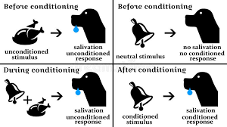
Principles of classical conditioning
Stimulus Generalization
Stimulus Discrimination
Aversive Conditioning

Slide 27
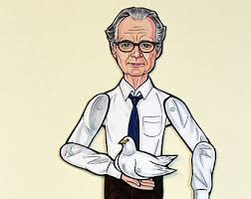
Behavioral Perspective
Operant Conditioning (Skinner)
Notes:
Operant conditioning, with Skinner's emphasis on reinforcement, involves the learning of behaviors that are not automatic.
Operant conditioning is a learning process in which an individual acquires a set of behaviors through reinforcement.
B. F. Skinner was the originator of operant conditioning.
Reinforcers that satisfy a biological need are primary reinforcers.
Secondary reinforcers derive their value from association with primary reinforcers. Money is a good example of a secondary reinforcer.
Positive reinforcement: a person repeats a behavior that leads to a reward.
The removal of an unpleasant stimulus is called negative reinforcement.
Punishment involves applying an aversive stimulus, such as scolding, which is intended to reduce the frequency of the behavior that preceded the punishment.
EXTINCTION is the cessation of behavior in the absence of reinforcement.
SHAPING is the process of reinforcing increasingly complex behaviors that come to resemble a desired outcome.

Slide 28
Principles
Primary reinforcers
Secondary reinforcers
Positive vs. negative reinforcement
Punishment
Extinction (occurs with classical or operant)
Shaping

Slide 29
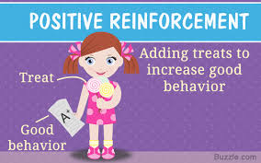
Positive reinforcement

Slide 30
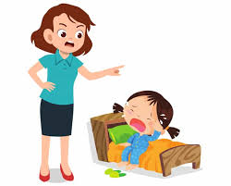
Negative Reinforcement

Slide 31
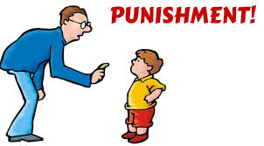
Punishment

Slide 32
Shaping

Slide 33
Behavior Therapy
Counterconditioning
Systematic Desensitization
Contingency Management
Token Economy
Shapping
Notes:
One method that is particularly useful in treating irrational fear is based on counterconditioning, the process of replacing an undesired response to a stimulus with an acceptable response.
Systematic desensitization: The client is exposed to progressively more anxiety-provoking images of stimuli while the client is in a relaxed state.
Contingency management is a form of behavioral therapy that involves the principle of rewarding a client for desired behaviors and not providing rewards for undesired behaviors.
Token economy: Residents who perform desired activities earn plastic chips that can later be exchanged for a tangible benefit.

Slide 34
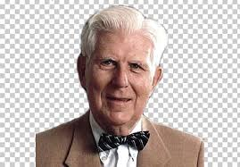
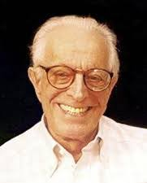
Cognitive Perspective
Albert Ellis
Aron Beck

Slide 35
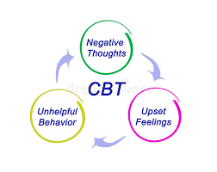
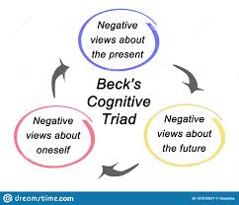
Cognitive behaviour therapy

Slide 36
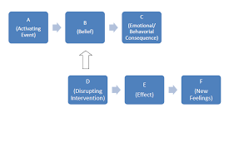
Rational Emotive Behaviour Therapy (ABC Theory)

Slide 37
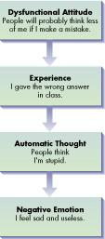
Cognitively Based Theory
Treatment focuses on
Automatic thoughts
Dysfunctional attitudes
Notes:
The cognitive theories of theorists like Beck emphasize disturbed ways of thinking.
In interventions based on behavioral theory, clinicians focus on observable behaviors, while those adhering to a cognitive perspective work with clients to change maladaptive thought patterns.
AUTOMATIC THOUGHTS: Ideas so deeply entrenched that the individual is not even aware that they lead to feelings of unhappiness and discouragement.
DYSFUNCTIONAL ATTITUDES: Personal rules or values people hold that interfere with adequate adjustment.
Even cognitively oriented theorists fail to provide an overall explanation of personality structure, restricting their observations to particular problem areas.

Slide 38
Biological Perspective
Within the biological perspective, disturbances in emotions, behavior, and cognitive processes are viewed as being caused by abnormalities in the functioning of the body.
Notes:
The central nervous system consists of the brain and the nerve pathways going to and from the spinal cord.
Neuron: Nerve cell.
Synapses: Where neurons meet to transmit electrochemical signals from one to another.
Axon: Part of the neuron that releases chemicals called neurotransmitters to transmit signal.
Dendrite: Receiving part of a neuron. A neuron may have numerous axons and dendrites.
An EXCITATORY SYNAPSE is one in which the message communicated to the receiving neuron makes it more likely to trigger a response.
An INHIBITORY SYNAPSE decreases the activity of the receiving neuron.
Neurons do not touch; instead, there is a gap at the juncture between neurons called the SYNAPTIC CLEFT.

Slide 39
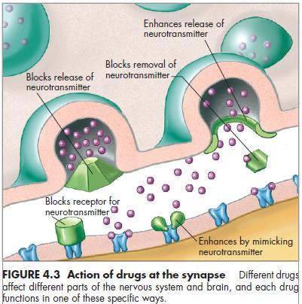
Neurotransmitter
A chemical substance released from a transmitting neuron (nerve cell) across a synapse to be absorbed by a receiving neuron
Examples:
acetylcholine
GABA
serotonin
dopamine
norepinephrine
enkephalins
Notes:
Excitatory neurotransmitters (e.g., norepinephrine) increase the likelihood a receiving neuron will trigger a response.
Inhibitory neurotransmitters (e.g., GABA) “slow down” the nervous system.
Enkephalins: the body’s naturally produced painkillers.
Researchers hypothesize that serotonin is involved in various disorders including OCD, depression, and eating disorders.
An excess of dopamine could cause symptoms of schizophrenia whereas a deficit causes trembling and difficulty walking, symptoms of Parkinson’s.

Slide 40
Genetic Influences
Deoxyribonucleic acid
(DNA):
23 sets of paired strands
spiral into double helix
contain information cells need to manufacture protein
organized into chromosomes
Notes:
A person's genetic makeup can play an important role in determining certain disorders such as predispositions toward depression or schizophrenia.
In trying to assess the relative roles of nature and nurture, researchers have come to accept the notion of an interaction between genetic and environmental contributors to abnormality.

Slide 41
Treatment: Somatic Therapies
Psychosurgery
Electroconvulsive Therapy (ECT)
Medication
Biofeedback
Notes:
Treatments based on the biological model involve a range of somatic therapies, the most common of which is medication.
More extreme somatic interventions include psychosurgery and electroconvulsive treatment (“shock treatment’).
Biofeedback is a somatic intervention in which clients learn to control various bodily reactions associated with stress.

